Slide 1

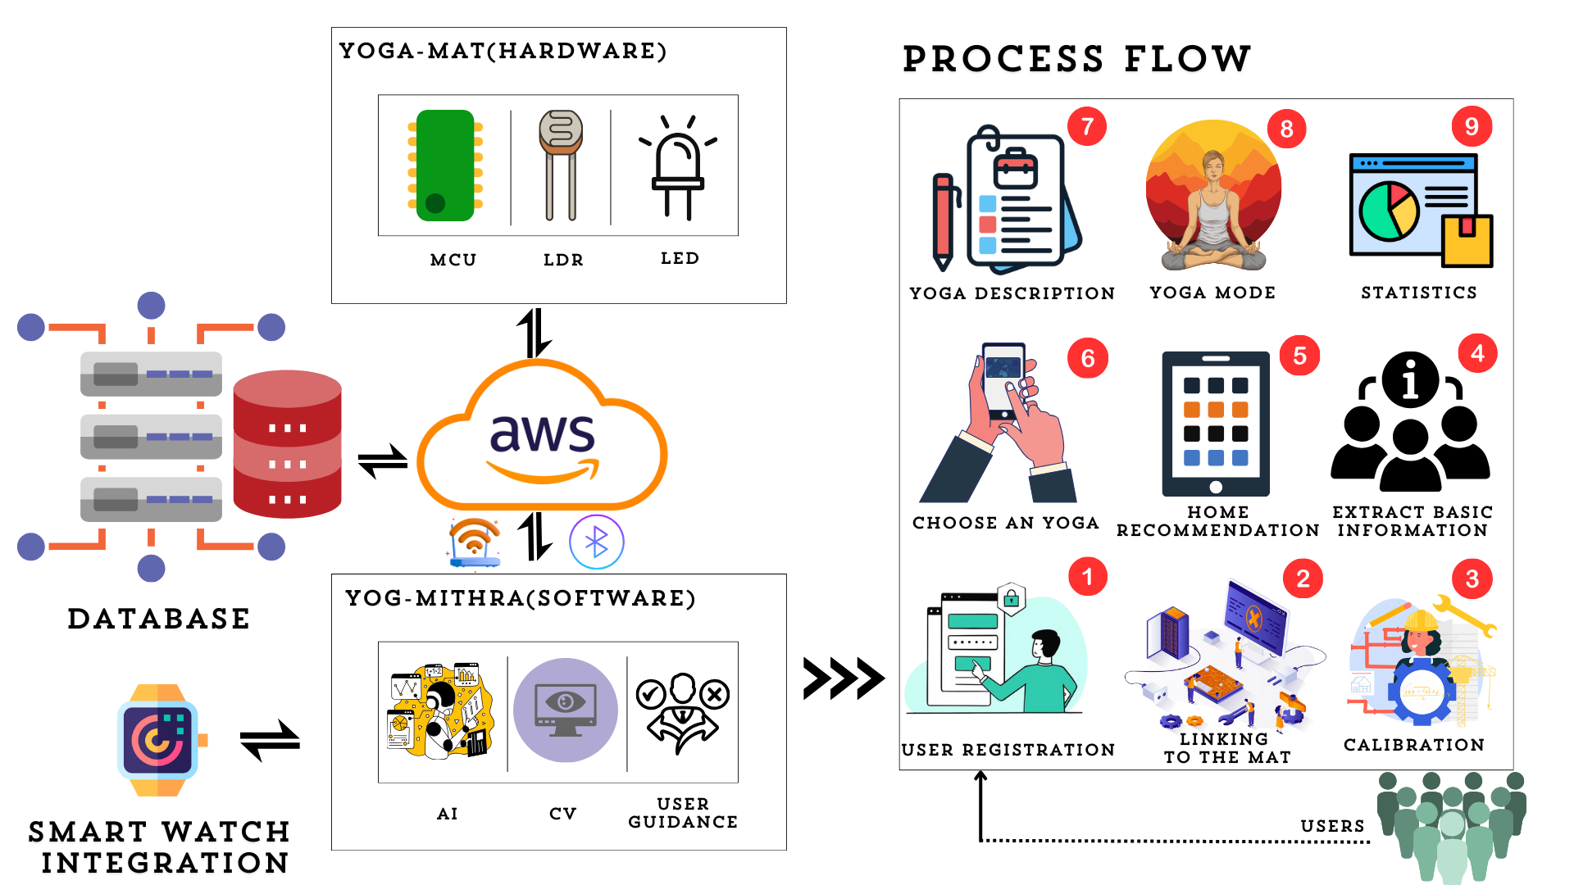



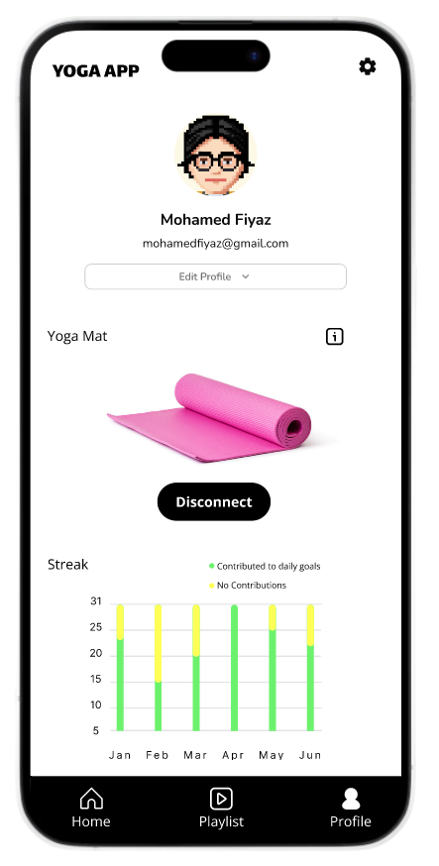
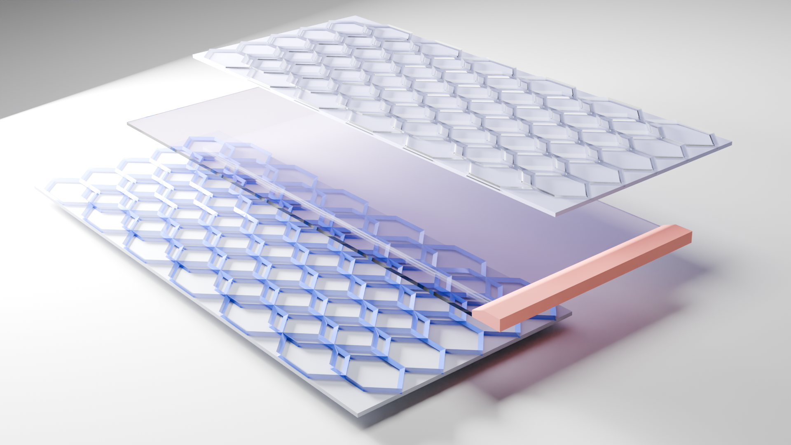
TECHNICAL APPROACH
TEAM G3N3SIS
FRONTEND
BACKEND
HARDWARE
<marcia akka>
<balji na : circuit diagram , if possible , add context and repaste the above img >
Tech Stack:

Slide 2













